Slide 1

Managerial Foundations of Information Systems
Introduction
MIFS
Lisa Murphy
Room: Left of AF room

Slide 2
Introduction
Module Aim
Module Learning Outcomes
Recommended Reading
Syllabus
Assessment
Schedule

Slide 3
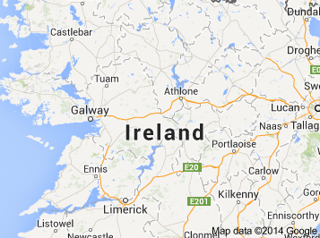

About…
Lisa Murphy School of Computing lisa.murphy@ncirl.ie

Slide 4

Module Aim
To analyse and explore how businesses can benefit from the use of information systems
Key Themes:
Technology
Management
Organisation

Slide 5

Module Learning Outcomes
On successful completion of this module, students will be able to:
Describe an Information System and what are its management, organisation, and technology dimensions
Assess how Information Systems have become so essential in business today
Summarise the broad ethical and social issues that are raised by widespread use of information systems
Evaluate how technologies can enhance the performance of a business
Describe the technologies and procedures necessary to ensure that systems are reliable and secure

Slide 6

Recommended Text
Management Information Systems: Global Edition, 11th Edition
Ken Laudon & Jane Laudon (2010)
Publisher:
Pearson Higher Education
ISBN
10:013609368X
13:9780136093688

Slide 7

Syllabus
Part One
Organisations, Management, and the Networked Enterprise
Chapter 1: Information Systems in Global Business Today
Chapter 2: Global E-Business: How Businesses Use Information Systems
Chapter 3: Information System, organisations, and Strategy
Chapter 4: Ethical and Social Issue in Information Systems

Slide 8
Syllabus
Part Two
Information Technology Infrastructure
Chapter 5: IT Infrastructure and Emerging Technologies
Chapter 6: Foundations of Business Intelligence
Chapter 7: Telecommunications, the Internet, and Wireless Technology
Chapter 8: Securing Information Systems

Slide 9

Assessment
In Class Assessments – 50%
Weekly CA’s (Week 3-13)
Final Examination 50%
Total 100%
Wk | CA %
3 | 2%
4 | 2%
5 | 15%
6 | 2%
7 | 2%
9 | 2%
10 | 15%
11 | 2%
12 | 4%
13 | 4%
50%

Slide 10

Schedule
BSHC
Tuesday – 3-5pm
BSHBIS
Thursday – 11-1pm
Lab: Thursday - 4-5pm

Slide 11
Exam Results Last Year
Fail (62)
Pass (15)
Why?

Slide 12

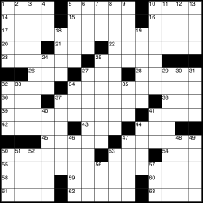
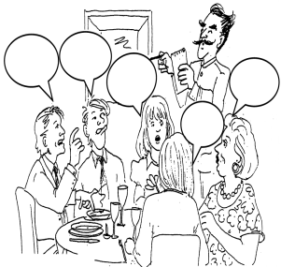
Activities
Case Studies
Learner Guides
Crosswords
Who wants to be a Millionaire
Double Jeopardy
Match up exercises
Role Play
Activity Sheets

Slide 13

Your feedback is important
More examples
More Activities
More sample exam questions

Slide 14

RECAP
Module Aim
Module Learning Outcomes
Recommended Reading
Syllabus
Assessment
Schedule

